Slide 1
Azure Networking
OCC Engineering team
Srichand Jakka

Slide 2
Agenda
1
Azure Virtual Network
2
Routing / NSG
3
Azure DNS
4
VPN Gateway
5
Q&A

Slide 3
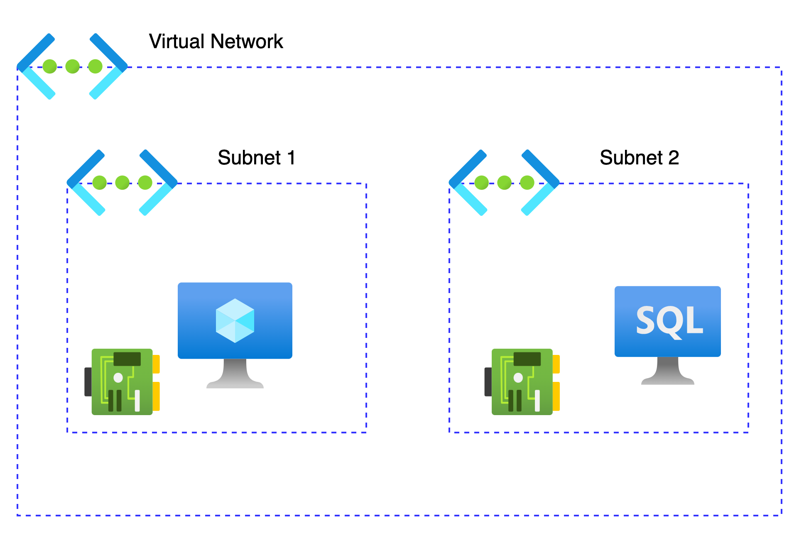
Azure Virtual Networks (VNETs)
Fundamental building block of the private network in Azure
Isolation and segmentation
Secure communication between Azure and on-premises resources
Internet communications
Filter network traffic
Network Routing
Connect virtual networks

Slide 4

VNET Concepts
Address space
Subnets
Define the address space in Classless inter-domain Routing (CIDR)
Ensure non-overlapping address spaces
Allowed address space
10.0.0.0 - 10.255.255.255 (10/8 prefix)
172.16.0.0 - 172.31.255.255 (172.16/12 prefix)
192.168.0.0 - 192.168.255.255 (192.168/16 prefix)
Range of IP address with in the VNET
Subnets must have a unique address range (CIDR)
Certain Azure services requires their own subnet
Azure reserves the first four and last IP address for a total of 5 IP addresses within each subnet
NOT Allowed
224.0.0.0/4 (Multicast)
255.255.255.255/32 (Broadcast)
127.0.0.0/8 (Loopback)
169.254.0.0/16 (Link-local)
168.63.129.16/32 (Internal DNS

Slide 5
Azure Routing
System Routes
Assigned by default to each subnet in a virtual network
Cannot be modified but it can be override with the system routes
Custom Routes
Closely monitor and control the traffic in the VNET
User-Defined Routes
Override the default system routes so traffic can be routed through firewalls or NVA
Border Gateway Protocol (BGP)
Exchange routes between two or more networks
Advertise on-premises routes to Azure when connected to an Azure datacenter through Azure ExpressRoute

Slide 6
Network Security Groups (NSG)
Filter network traffic to and from Azure resources
Assigned to a network interface or a subnet
Supports TCP, UDP, and ICMP, and operate at Layer 4 of the OSI model
Rules are evaluated by priority, using the 5-tuple information to allow or deny the traffic
Property | Explanation
Name | A unique name within the network security group.
Priority | A number between 100 and 4096.
Source and destination | Any, or an individual IP address, classless inter-domain routing (CIDR) block (10.0.0.0/24, for example), service tag, or app security group.
Protocol | TCP, UDP, or Any.
Direction | Whether the rule applies to inbound or outbound traffic.
Port range | An individual port or range of ports.
Action | Allow or deny the traffic.

Slide 7
Default Security Rules
Inbound traffic rules
Priority | Rule name | Description
65000 | AllowVnetInbound | Allow inbound coming from any VM to any VM within the subnet
65001 | AllowAzureLoadBalancerInbound | Allow traffic from the default load balancer to any VM within the subnet
65500 | DenyAllInBound | Deny traffic from any external source to any of the VMs
Outbound traffic rules
Priority | Rule name | Description
65000 | AllowVnetOutbound | Allow outbound going from any VM to any VM within the subnet
65001 | AllowInternetOutbound | Allow outbound traffic going to the internet from any VM
65500 | DenyAllOutBound | Deny traffic from any internal VM to a system outside the virtual network

Slide 8
Azure DNS
Fully managed cloud service to host domain name system (DNS) domains/DNS Zones
More Resilient to network failure when compared with on-prem traditional DNS servers
Integration with azure native resources
Supports all common DNS record types including A, AAAA, CNAME, MX, PTR, SOA, SRV, and TXT records
Public DNS Zones
Hosting zone records for the hosts to be resolved on the internet
Support all DNS record types
Used as an alias record set to refer to an Azure resource, such as an Azure public IP address, an Azure Traffic Manager profile, or an Azure Content Delivery Network (CDN) endpoint
Private DNS Zones
Manage and resolve domain names in the virtual network without the need of traditional DNS solutions
Automatic hostname record management
Support for Azure private endpoint DNS

Slide 9
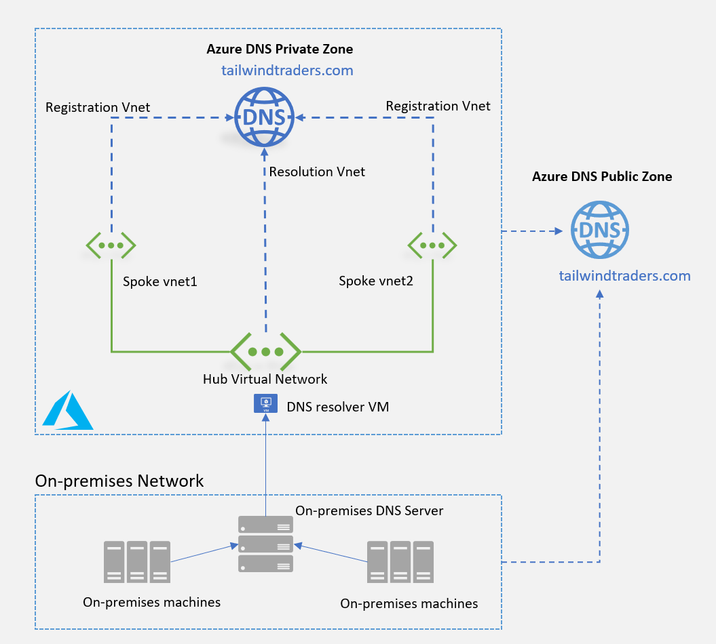
Azure DNS

Slide 10
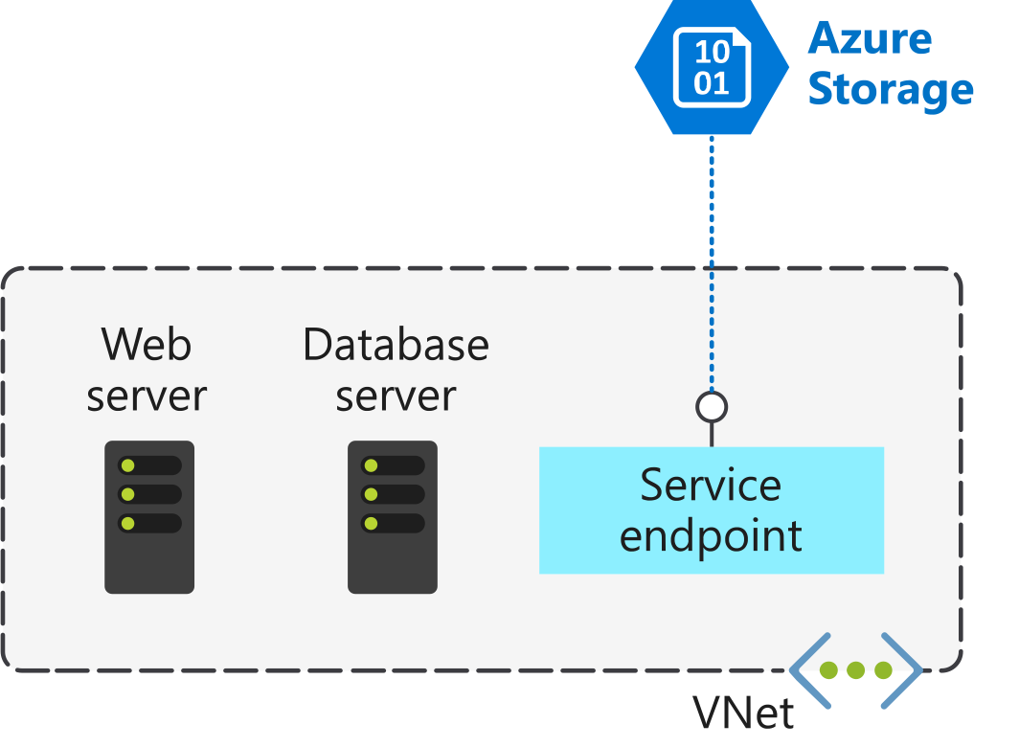
Service Endpoints
Extend private address space by providing direct connection to Azure services
Improved security for Azure service resources communication
Service traffic will remain on the Azure backbone, and doesn’t go over the Internet
Enabled per subnet

Slide 11
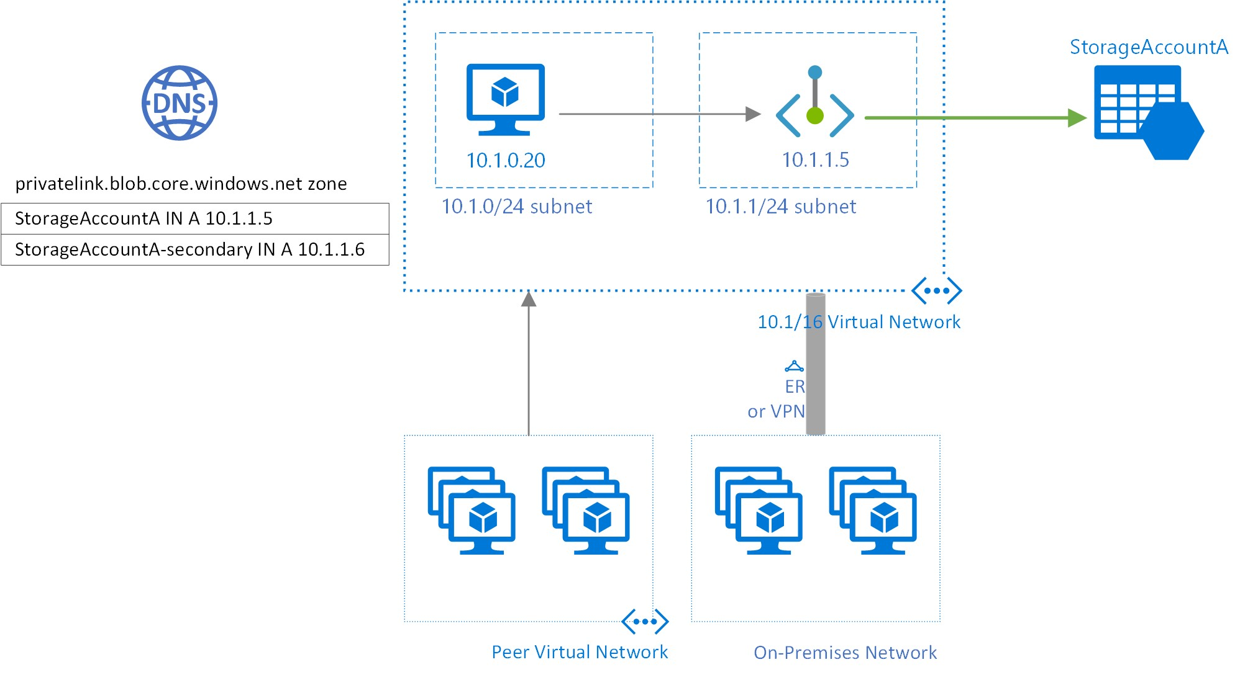
Private Endpoints
Connect privately and securely to Azure PaaS services
Creates a network interface with a private IP in the virtual network
Must be deployed in the same region as VNET
Integration with private DNS zones

Slide 12
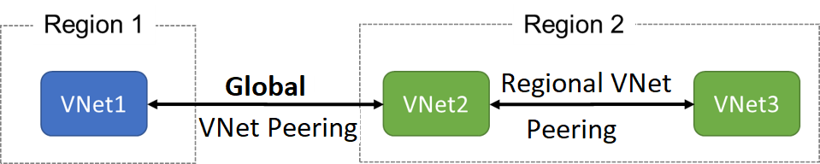
VNet Peering
Connect two virtual networks for seamless communication
Low-latency, high bandwidth connection
No down-time to resources when creating the peering or after the peering
Regional VNet peering
Connects Azure virtual networks in the same region
Global VNet peering
Connects Azure virtual networks in different regions

Slide 13
Azure VPN Gateway
Virtual Network Gateway service to send/receive encrypted traffic between a virtual network and on-premises over the public internet
Connect separate virtual networks using an encrypted tunnel across the Microsoft network backbone
Point-to-site VPN connection
To connect a single computer to an Azure virtual network
A P2S connection is established by starting it from the client computer
This type of VPN connection is commonly used by remote workers with portable computers
Site-to-site VPN connection
To connect one network to another network with traffic between the two networks passing across an encrypted VPN tunnel.
This type of VPN connection is commonly used to connect on-premises sites to Azure or Azure virtual networks to each other

Slide 14



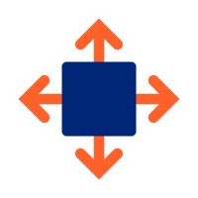
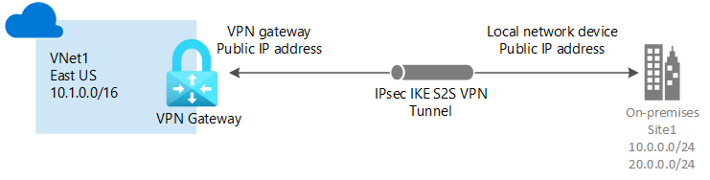
VPN GW Components
Virtual Network
Gateway Subnet
Public IP Address
Local network gateway
Enough address space for the additional subnet that need for the VPN gateway
Non-overlapping address spaces with on-prem
A subnet called GatewaySubnet for the VPN gateway
Requires at least a /27 address mask
Basic-SKU dynamic public IP address
Provides a public-routable IP address as the target for the on-premises VPN device
Define the on-premises network's configuration where the VPN gateway will connect
Includes the on-premises VPN device's public IPv4 address and the on-premises routable networks

Slide 15
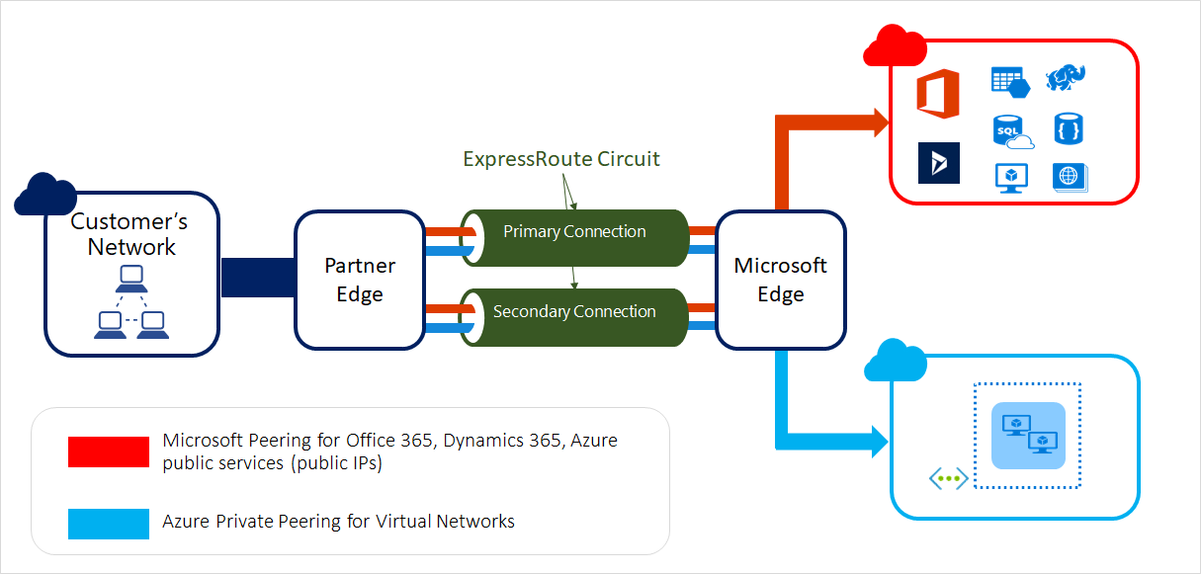
Express Route
Extend on-premises network to MS Cloud over a private connection
Don’t go over the public internet
Layer 3 connectivity between on-prem and cloud through a connectivity provider
Faster speed, low latency and higher security

Slide 16
Q&A

